Slide 1
Infographic Social Toolkit
www.pathto15|55.org

Slide 2
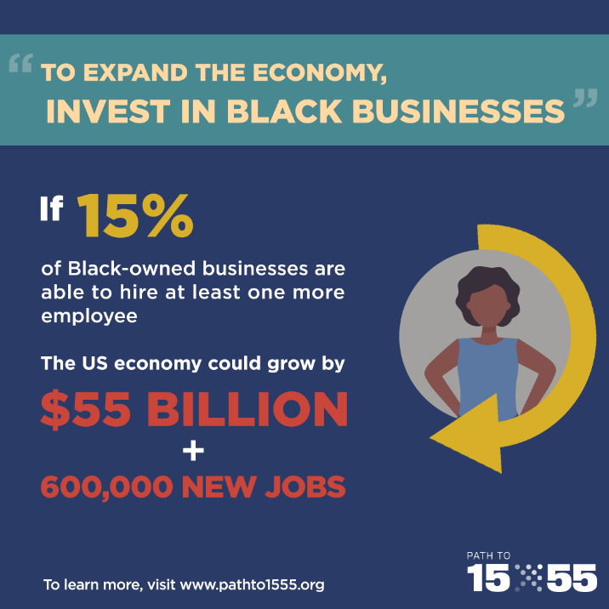
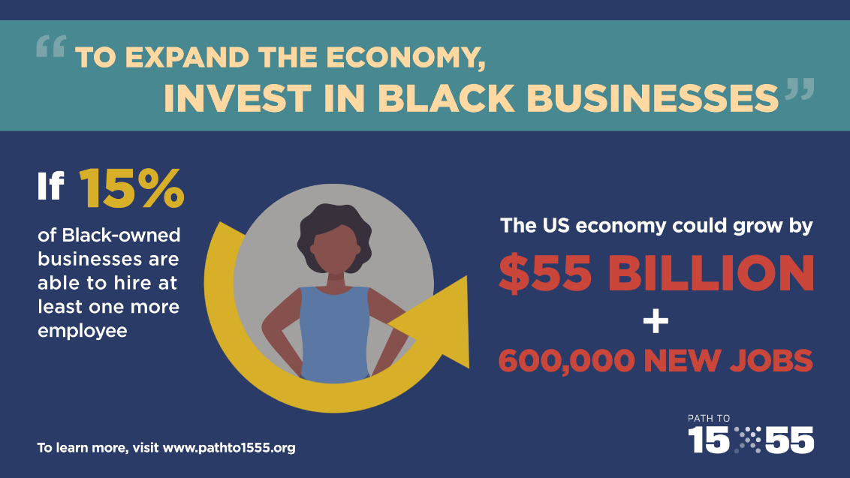
SAMPLE SOCIAL CONTENT
Twitter
15% of Black businesses hiring at least one employee means $55 billion and 600,000 jobs. Join us at pathto1555.org
Facebook/LinkedIn
Did you know that is 15% of Black businesses hired one more employee, the US economy would add $55 billion and 600,000 jobs? @Brookings Institution released a new report inspired by the work of Path to 15|55. Learn more about our work and the report on pathto1555.org

Slide 3
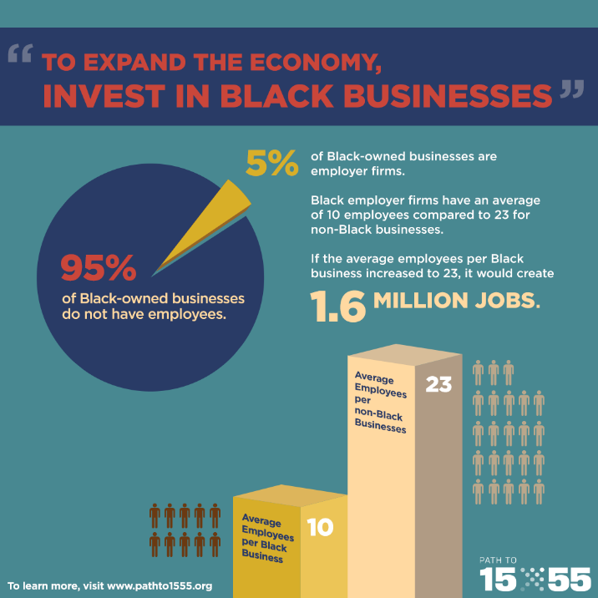
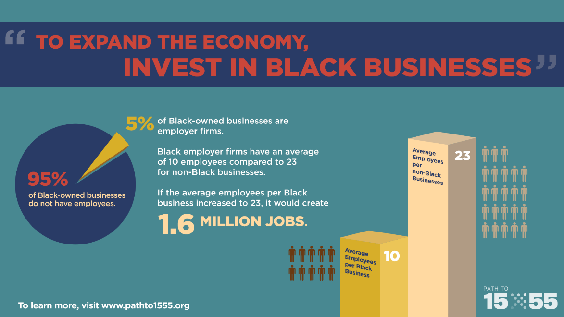
SAMPLE SOCIAL CONTENT
Twitter
If Black employer firms had the same number of employees as non-Black firms, we could create 1.6 M jobs. Learn more in a new report from @BrookingsInst on pathto1555.org
Facebook/LinkedIn
A new report from @Brookings Institute found that Black employer firms have an average of 10 employees compared to 23 for non-Black firms. Reaching parity would mean 1.6 M jobs. Read the report and learn more at pathto1555.org.

Slide 4
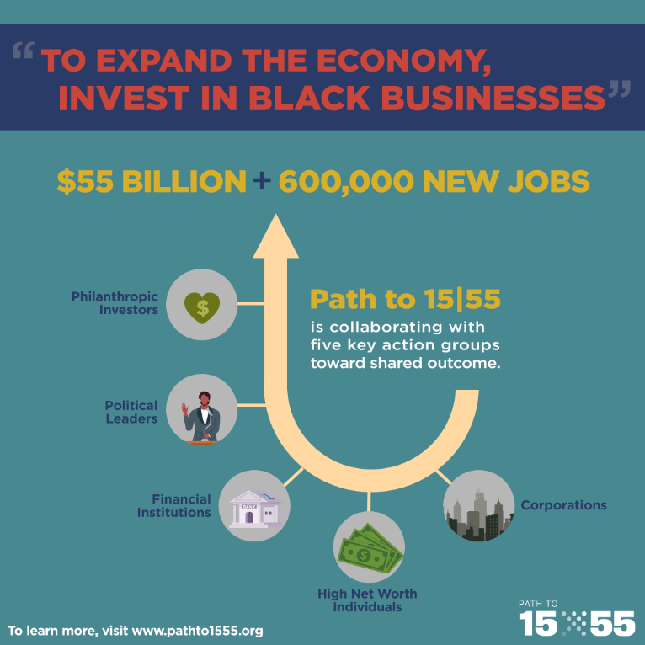
SAMPLE SOCIAL CONTENT
Twitter
Philanthropies, politicians, high net worth individuals, financial institutions, corporations: join us on the Path to 15|55 pathto1555.org
Facebook/LinkedIn
Philanthropies, politicians, high net worth individuals, financial institutions, corporations: join us on the Path to 15|55. Learn more about what it takes to get there in a new report from @Brookings Institute on pathto1555.org

Slide 5
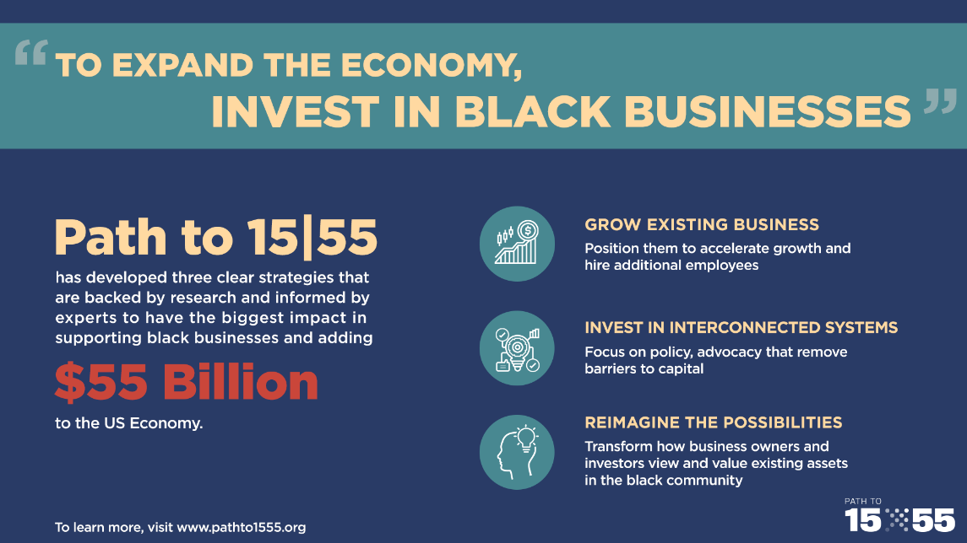
SAMPLE SOCIAL CONTENT
Twitter
Investing in Black businesses? You need to focus on growth, removing barriers, and reimagining their value. Learn more in a new report from @BrookingsInst on pathto1555.org
Facebook/LinkedIn
There are three clear strategies for investing in Black businesses. Join the Path to 15|55 and help add $55 billion to the economy through supporting black businesses. Learn what's behind the recommendations in a new report from @Brookings Institute on pathto1555.org

Slide 6
www.PathTo15|55.org
PATHTO15|55@CAPEQIMPACT.COM

